Slide 1
Air Transport Network Networking Science – NS101 Final Project
Marcelo José Rovai
Master Data Science
March, 2019

Slide 2
Motivation
Modeling air transport networks aims airline companies to organize their routes in a cost-efficient way and therefore maximize their profits.
Air transport network models are also the tool to investigate system robustness. They help to determine weaknesses of the system in case of various kinds of disruptions.
An alternative application is modeling ”human deceases networks”. Air transport network is used by millions of people every day, therefore it plays key role in the spread of some infections, such as Influenza, H1N1 or SARS

Slide 3
Research Questions
How is the Air Transport Network (ATN) structured in terms of nodes (airports) and links (routes)? Is the ATN similar to Social Networks?
How to calculate the best route between destinations?
How to hank the most important airports? How to analyze weakness?
How the ATN can be analyzed in terms of communities?
How studying ATN can help on human deceases spread prevention?
How different are the topologies of distinct Air Companies?

Slide 4
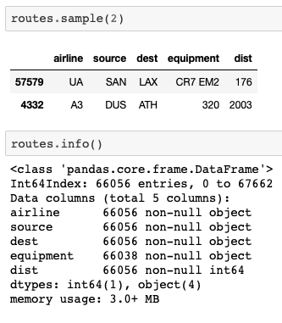
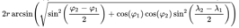
Dataset
“OpenFlights Airports Database” (January 2017):
Over 10,000 airports (Lat, Long, Alt, IATA code)
https://raw.githubusercontent.com/jpatokal/openflights/master/data/airports.dat
“OpenFlights/Airline Route Mapper Route Database” (June 2014):
67,663 routes
3,321 airports
548 airlines
https://raw.githubusercontent.com/jpatokal/openflights/master/data/routes.dat
dist =

Slide 5
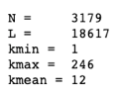
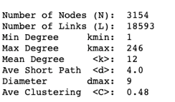
Creating an Air Transport Network graph
Graph is not connected, having a giant component that contains more than 99% of all airports.
The giant component was used (undirect graph)
The nodes are airports and its attributes are altitude and geo position.
The links, are routes between 2 airports and its attributes are airline, distance and aircraft used.
Complete Network
Giant Component

Slide 6
Networking Analysis
There are a few airports with hundreds of routes
More than 1/3 of all routes has 3 or less legs, being 4 the average.
The clustering coefficient C, is defined as the probability that two cities that are directly connected to a third city also are directly connected to each other.
C is typically larger for the air transportation network than for a random graph and that it decreases with K size, but slower than d, for example.
These results are consistent with the expectations for a small-world network but not with those for a random graph.

Slide 7
Networking Analysis
Ultra-Small-World Network
Few HUBs (airport with high number of connections) appears and the pattern follows a "Power Law", for great part of distribution.
The network shows a scale-free feature
Hubs in scale-free networks affect the small world property, Barabasi calls networks in this regime ultra-small, as the hubs radically reduce the path length.
They do so by linking to a large number of small-degree nodes, creating short distances between them."

Slide 8
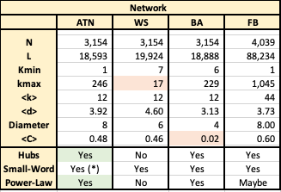
Networking Analysis Comparing models
Watts-Strogatz (WS) model is intended to model networks in the natural and social sciences (“Small-World”), but fails on degree (k) distribution (not prevent the appearance of Hubs).
The BA model is better than the WS model at reproducing the degree distribution (Power-Law), but fails on C.
FaceBook has huge hubs (k > 1,000), but for k < 200, similar to ATN.
Conclusion: ATN is a “Scale-Free” and “Small World” type network, where its behavior is very similar to Social networks as Facebook.

Slide 9
Research Questions
How is the Air Transport Network (ATN) structured in terms of nodes (airports) and links (routes)? Is the ATN similar to Social Networks?
How to calculate the best route between destinations?
How to hank the most important airports? How to analyze weakness?
How the ATN can be analyzed in terms of communities?
How studying ATN can help on human deceases spread prevention?
How different are the topologies of distinct Air Companies?

Slide 10
“Geo mapping” the Air Network

Slide 11
“Geo mapping” the Air Network
Node size ➔ “k”
Node color ➔ Altitude

Slide 12
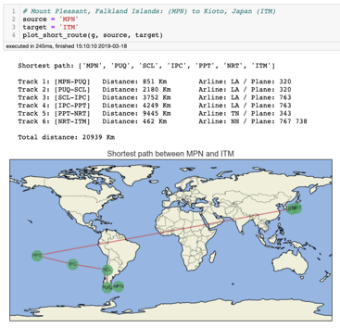
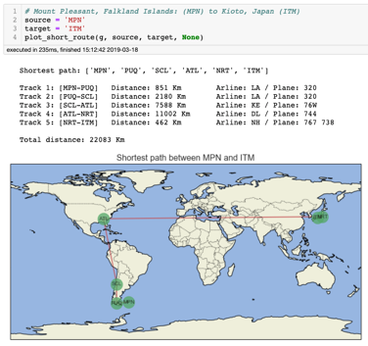
Calculating the best route Using Dijkstra’s algorithm
Examples of best route calculation using Dijkstra's algorithm, having (a) distance as a “weight” and (b) minimum number of routes (no weight)”:
a.
b.

Slide 13
Research Questions
How is the Air Transport Network (ATN) structured in terms of nodes (airports) and links (routes)? Is the ATN similar to Social Networks?
How to calculate the best route between destinations?
How to hank the most important airports? How to analyze weakness?
How the ATN can be analyzed in terms of communities?
How studying ATN can help on human deceases spread prevention?
How different are the topologies of distinct Air Companies?

Slide 14
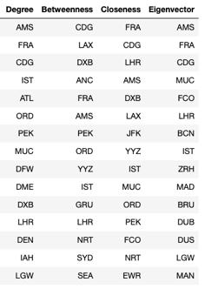
Centrality

Slide 15
Research Questions
How is the Air Transport Network (ATN) structured in terms of nodes (airports) and links (routes)? Is the ATN similar to Social Networks?
How to calculate the best route between destinations?
How to hank the most important airports? How to analyze weakness?
How the ATN can be analyzed in terms of communities?
How studying ATN can help on human deceases spread prevention?
How different are the topologies of distinct Air Companies?

Slide 16
Community detection
Using Louvain algorithm

Slide 17
Community detection
On previous map was possible to confirm that the airports are connected in "communities" with some geographic correlation. Even though geographical distance plays a clear role in the definition of the communities, the composition of some of the communities cannot be explained by purely geographical considerations. For example, India is mostly grouped with the Arabic Peninsula countries and with countries in Africa. These facts are consistent with the important role of political factors in determining community structure [4].These facts are consistent with the important role of political factors in determining community structure, as we can see on the Latin America case (Cuba & Venezuela):

Slide 18
Research Questions
How is the Air Transport Network (ATN) structured in terms of nodes (airports) and links (routes)? Is the ATN similar to Social Networks?
How to calculate the best route between destinations?
How to hank the most important airports? How to analyze weakness?
How the ATN can be analyzed in terms of communities?
How studying ATN can help on human deceases spread prevention?
How different are the topologies of distinct Air Companies?

Slide 19
“Geo mapping” the Air Network – “Ego”
Ego networks consist of a focal node ("ego") and the nodes to whom ego is directly connected to (these are called "alters") plus the ties, if any, among the alters. This is a very important tool on Air Transport Network analysis, for example to study how human decease can spread along the network

Slide 20
Decease outbreak, having Atlanta as starting point
1

Slide 21
Decease outbreak, having Atlanta as starting point and Johannesburg as next stop
2

Slide 22
Decease outbreak, having Atlanta as starting point and Seoul as next stop
2

Slide 23
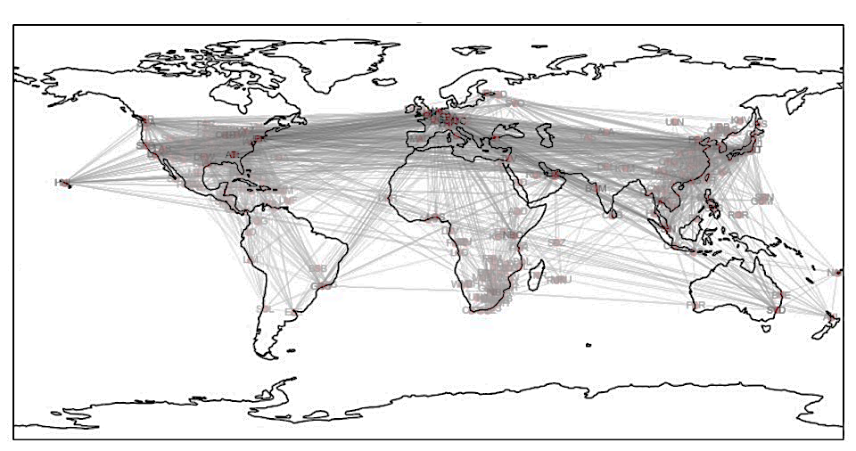
JNB ⬅ ATL ➔ ICN
2
1
2

Slide 24
Research Questions
How is the Air Transport Network (ATN) structured in terms of nodes (airports) and links (routes)? Is the ATN similar to Social Networks?
How to calculate the best route between destinations?
How to hank the most important airports? How to analyze weakness?
How the ATN can be analyzed in terms of communities?
How studying ATN can help on human deceases spread prevention?
How different are the topologies of distinct Air Companies?

Slide 25
Comparing Air Companies Topologies
LATAM
RYANAIR
Looking on both air companies network distribution, we can verify what is described on [6], that the structure of of low-cost airlines, as Ryanair, the biggest European low-cost company, has a densely connected core, in opposition to companies as LATAM or other big companies.

Slide 26
Conclusion
On this project, the main idea, was to analyze the structure of the world-wide air transport network, understanding how we could define the best possible routes between two destinations, not only in economic terms, but also to prevent the spread of human deceases.
The study enables us to unveil a number of significant results. The worldwide air transport network is a "Small-World" network (*), similar to social networks as Facebook, in which (i) the number of nonstop connections from a given city and (ii) the number of shortest paths going through a given city have distributions that are scale-free. Surprisingly, the nodes with more connections are not always the most central in the network. We hypothesize that the origin of such a behavior is the metacommunity structure of the network. We find the communities in the network and demonstrate that their structure can only be understood in terms of both geographical and political considerations.
(*) According Barabasi, the presence of hubs in scale-free networks affect the small world property. "Airlines build hubs precisely to decrease the number of hops (stops) between two airports". Barabasi calls networks in this regime "Ultra-Small, as the hubs radically reduce the path length.

Slide 27
Resources
1. Networking Science
2. Think Complexity
3. IPython Cookbook, Second Edition
4. The worldwide air transportation network
5. Revealing the structure of the world airline network
6. Modelling the Air Transport with Complex Networks: a short review
7. Reliability Analysis for Aviation Airline Network Based on Complex Network
8. Finding The Shortest Path, With A Little Help From Dijkstra
9. An Introduction to Graph Theory and Network Analysis
10. Catching that flight: Visualizing social network with Networkx and Basemap
11. The Hidden Geometry of Complex, Network-Driven Contagion Phenomena

Slide 28
Notebook and Datasets
Datasets:
https://github.com/Mjrovai/UDD_Master_Data_Science/tree/master/NS101-WW_Air_Transport_Network/data
Notebook:
https://github.com/Mjrovai/UDD_Master_Data_Science/tree/master/NS101-WW_Air_Transport_Network

Slide 29
Thank you
Marcelo José Rovai
Santiago, Chile March 19th 2019

